Slide 1

WinterFest: Healthy You – Healthy Heart
Solomon Track in Cabot Cage, Valentine’s Day 2014
Sponsored by The Healthy You Team and Virgin Pulse

Slide 2

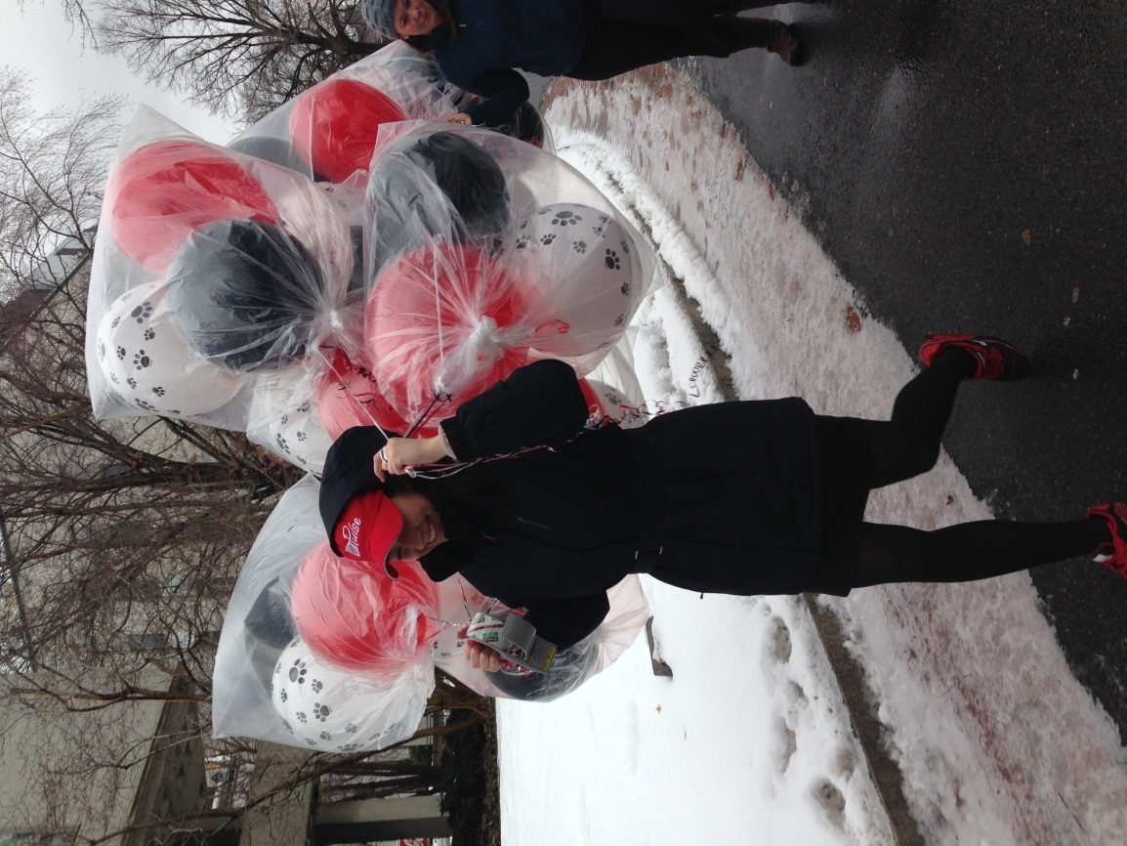

Slide 3
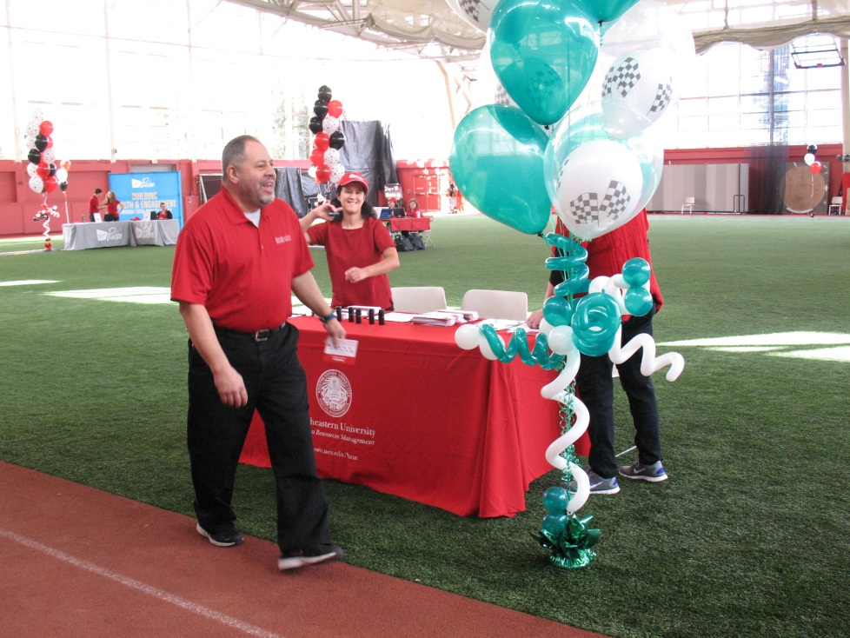
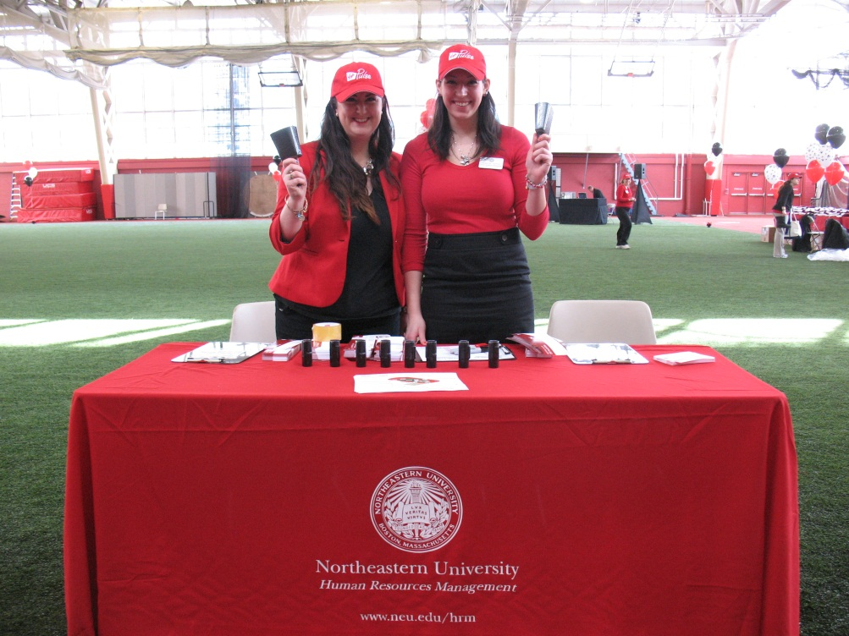

Slide 4
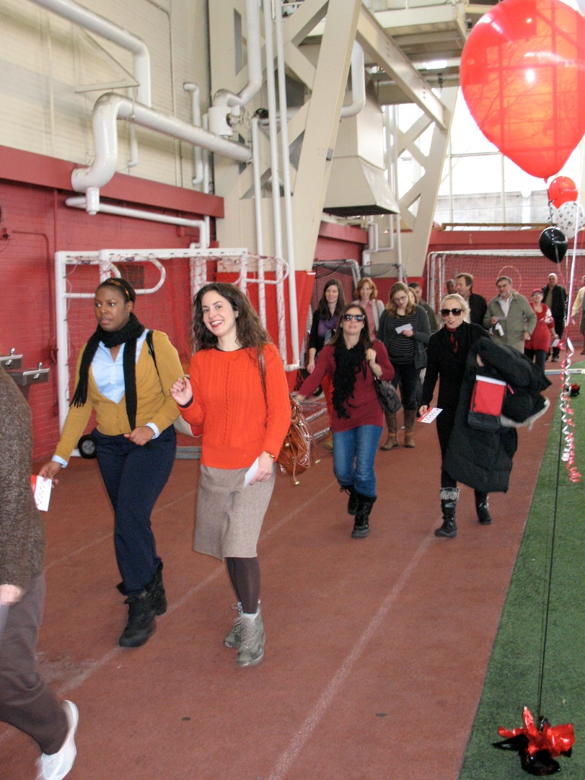
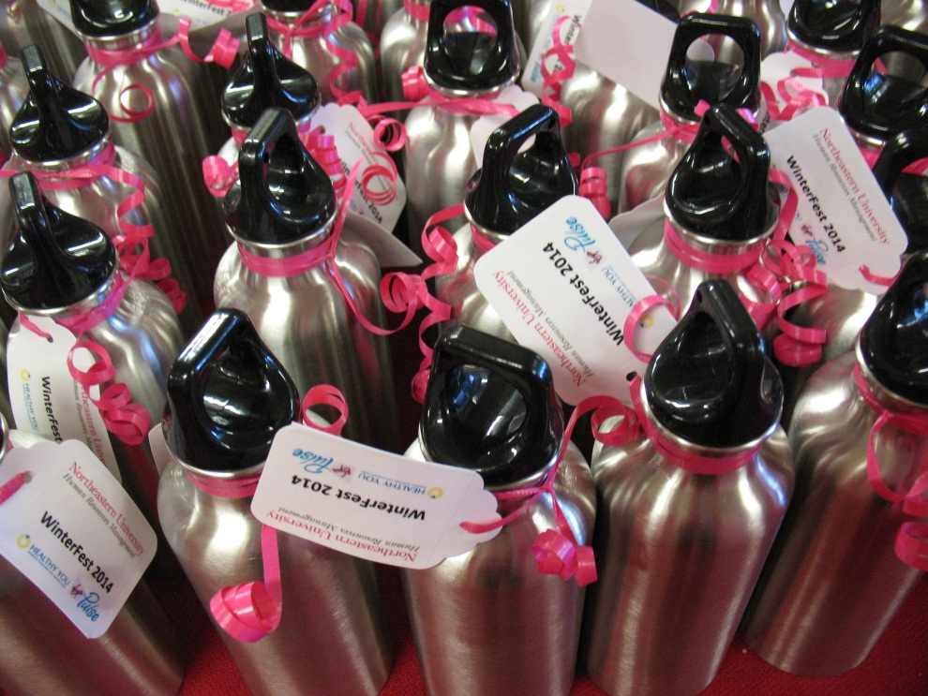

Slide 5
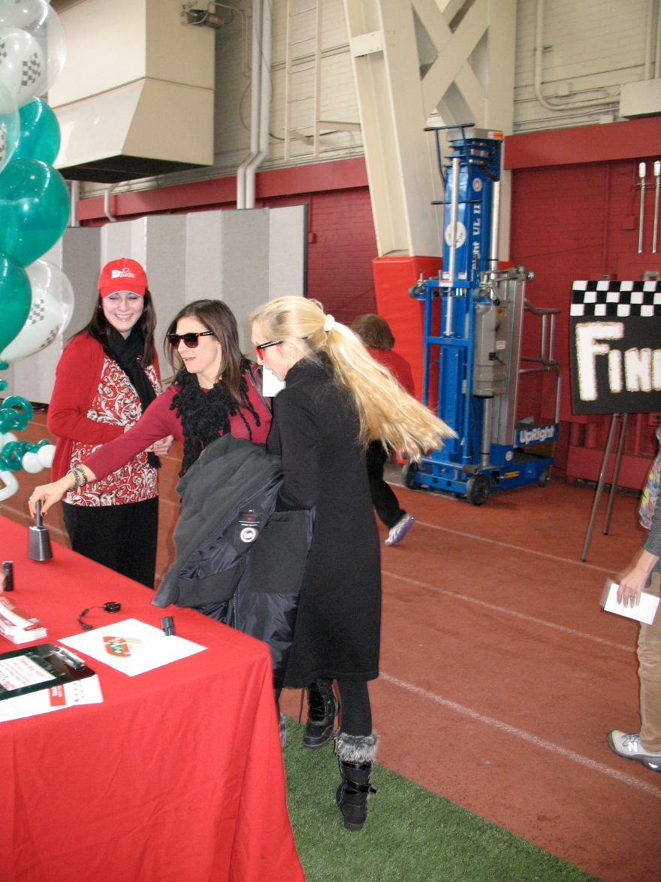
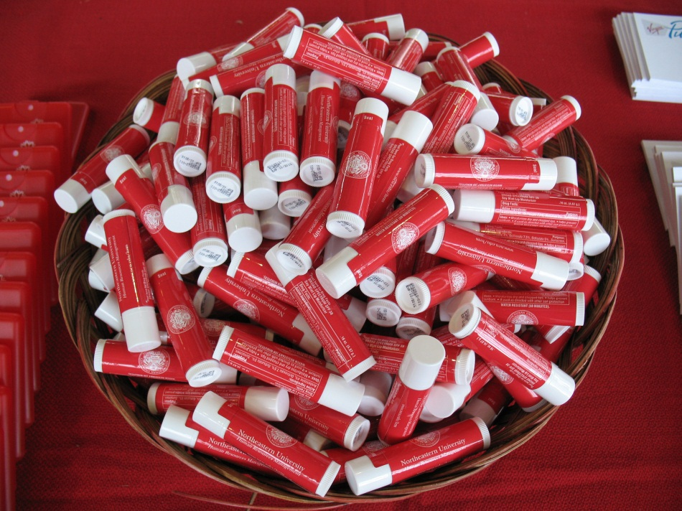

Slide 6
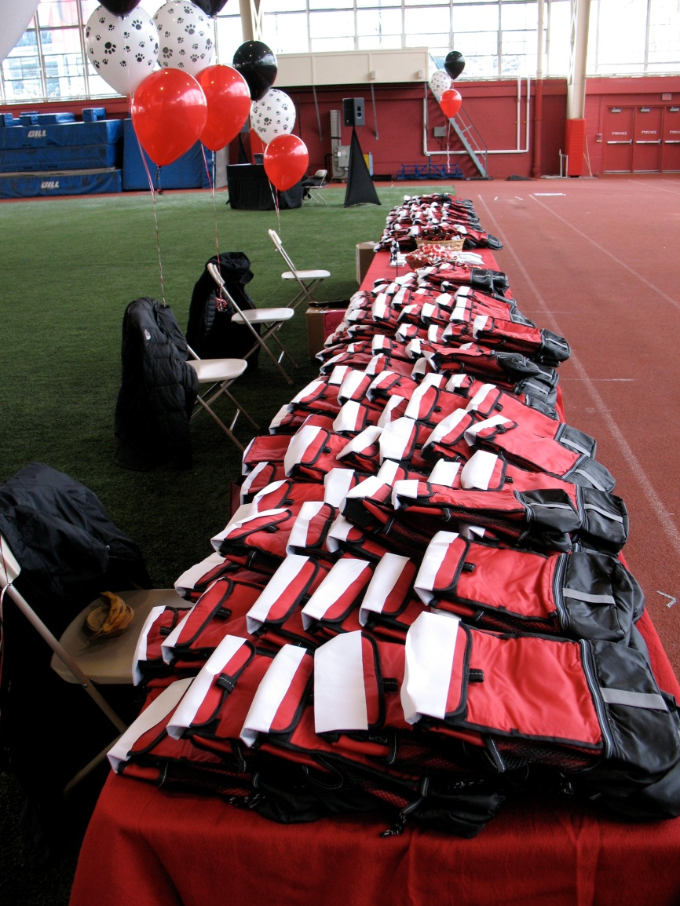
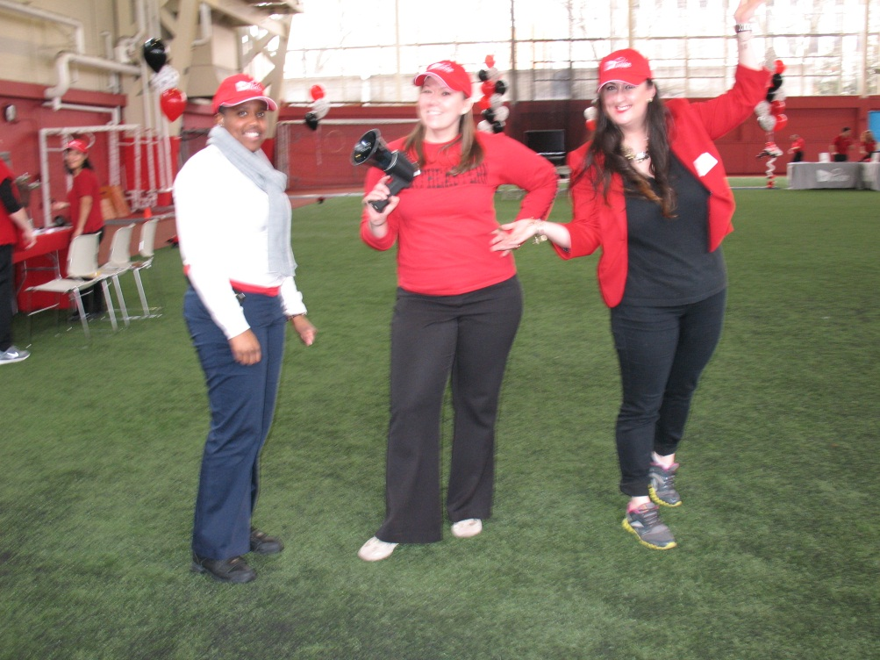

Slide 7
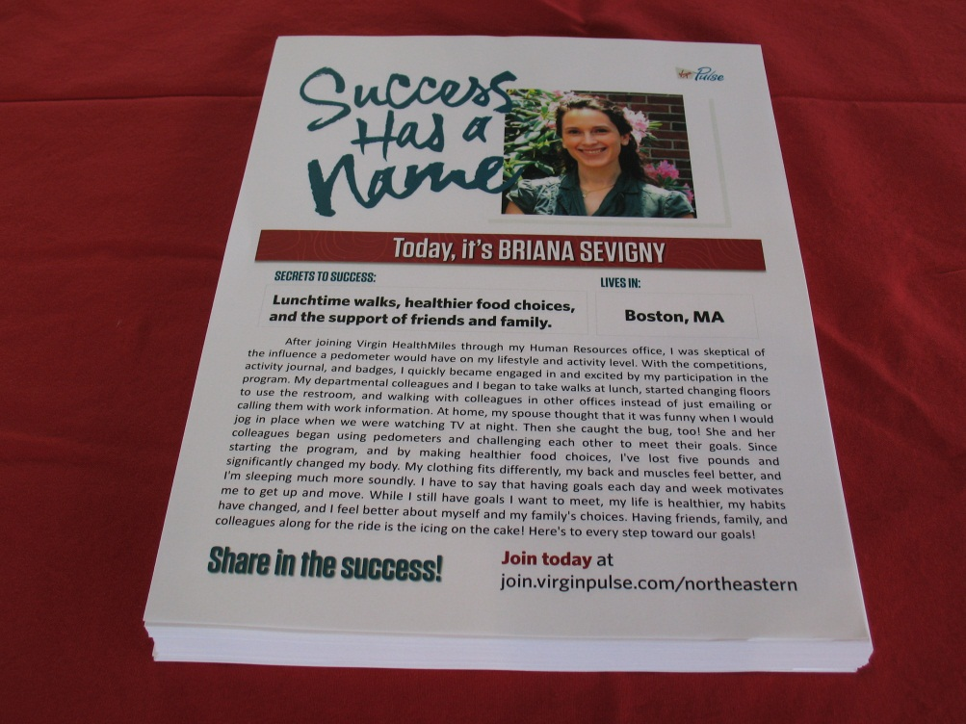
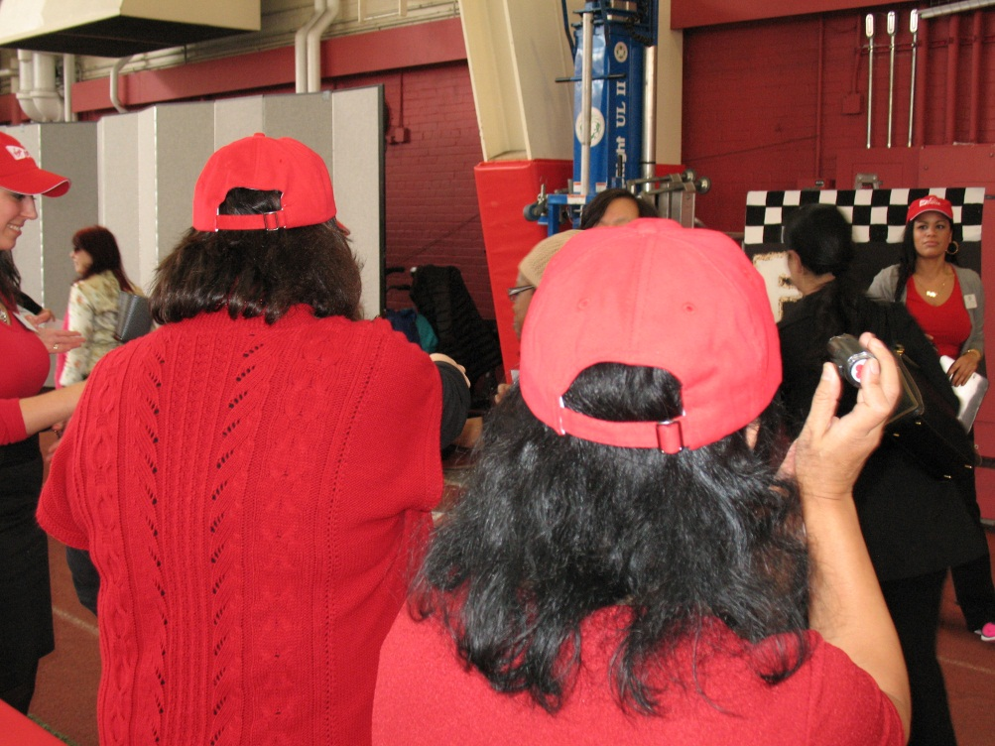

Slide 8
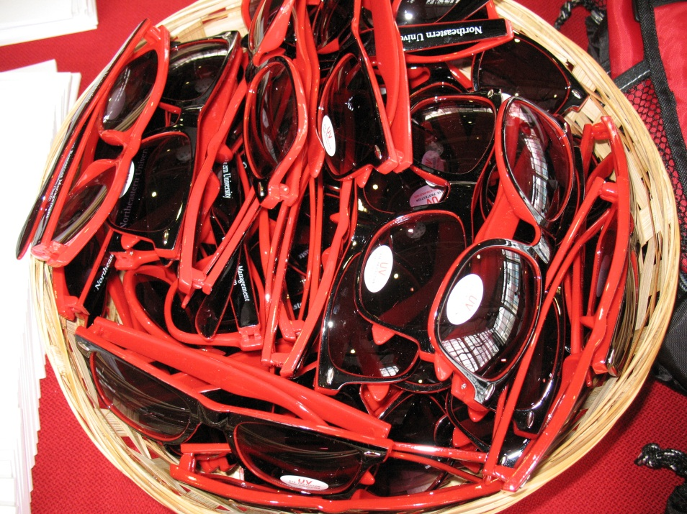
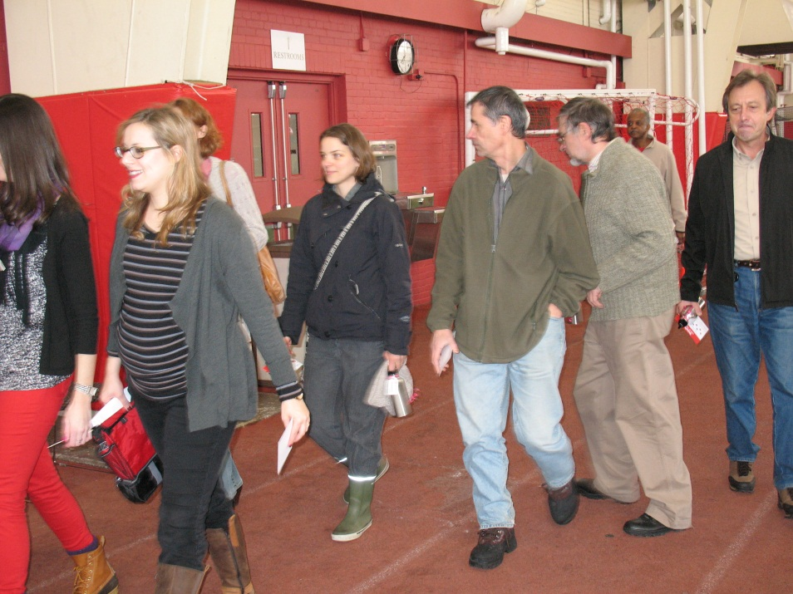

Slide 9
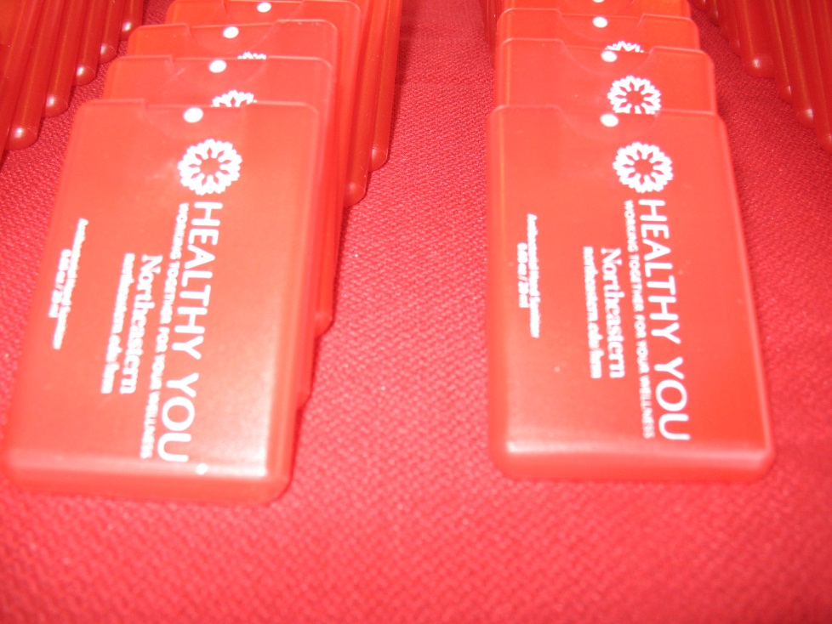
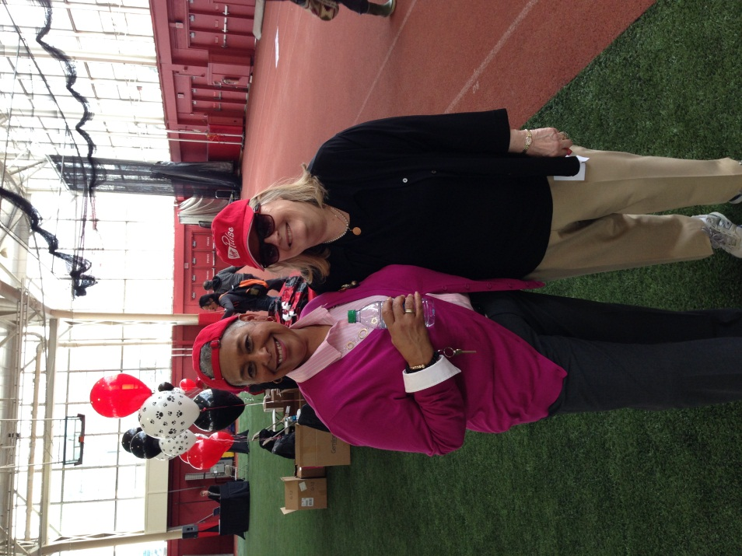

Slide 10
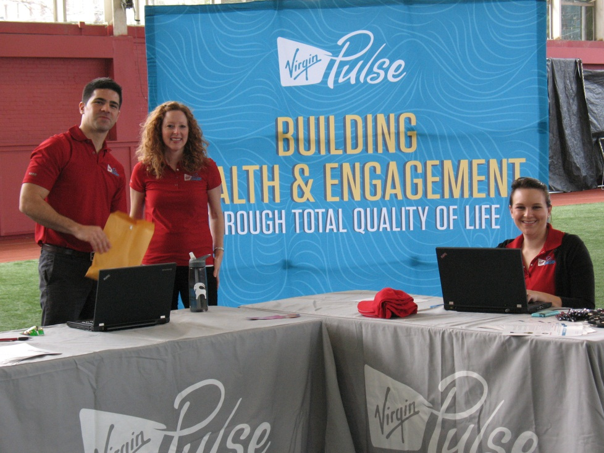
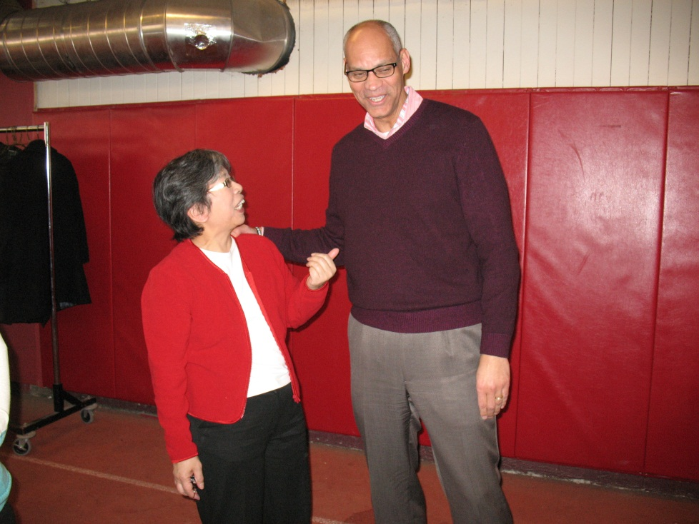

Slide 11
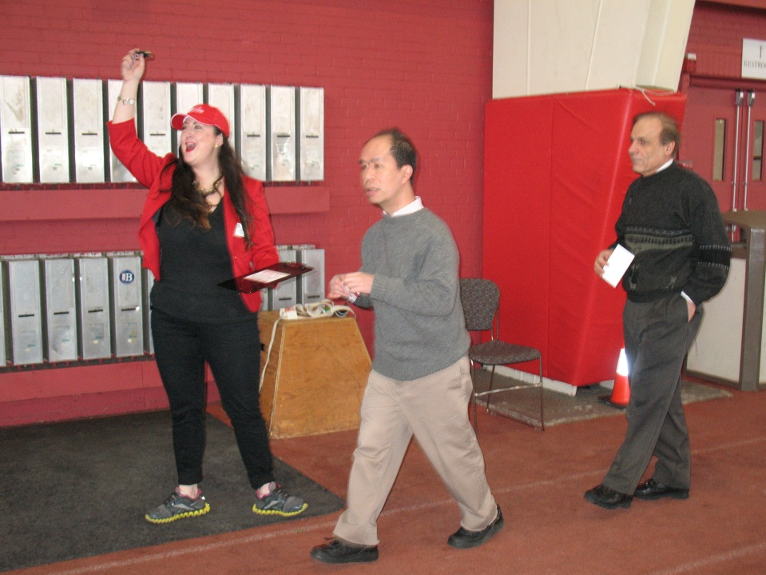
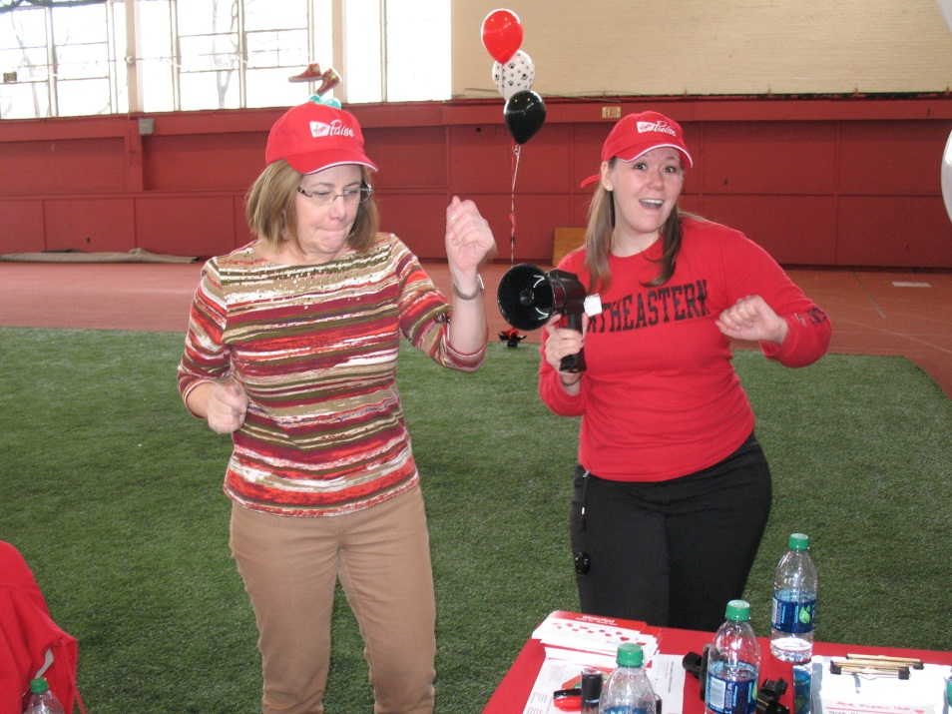

Slide 12
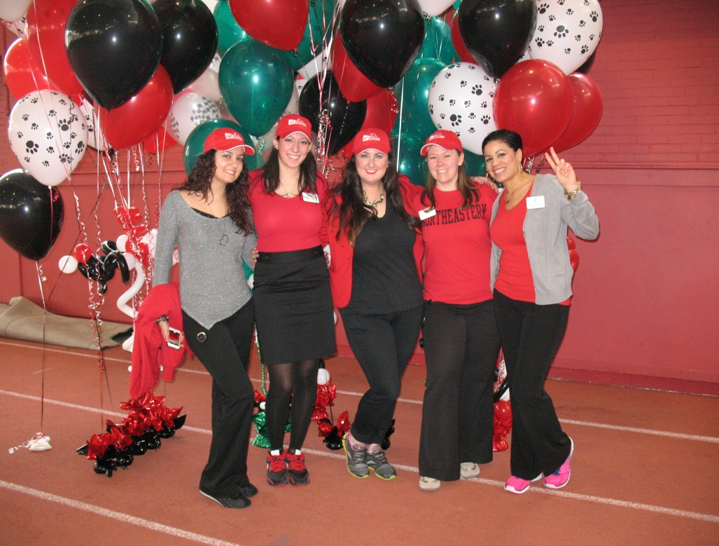
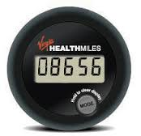
GoZone: Your Passport to HealthCash!
Earn up to $75/Quarter

Slide 13
A GoZone is Your Passport to HealthCash and Fun!
It’s as simple as 1, 2, 3!
Wear It.
Upload Your Steps.
Earn HealthCash, up to $75 Each Quarter!
Already Active?
Great! Enroll and Earn HealthCash, up to $75 each quarter!
Want to Increase Your Activity Level?
Enroll and Earn HealthCash, up to $75 each quarter!
The more you do, the more you earn!
To enroll, go to: www.virginhealthmiles.com/northeastern

